Slide 1
Magic of Markets

Slide 2
How long and how much to make chicken sandwich from scratch?

Slide 3
https://www.youtube.com/watch?v=URvWSsAgtJE&t=1s

Slide 4
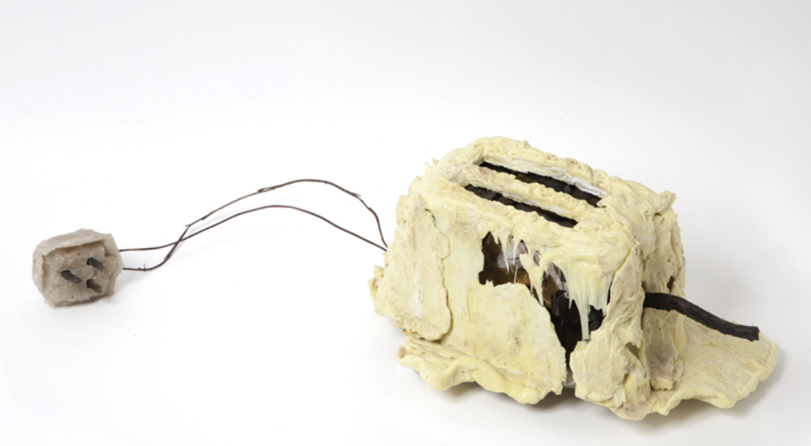
“Left to his own devices he couldn't build a toaster. He could just about make a sandwich and that was it.” – Douglas Adams

Slide 5
Markets as the original A.I.
When you ask an A.I. something, it is pulling from billions of written words to search and produce an answer for you. It’s like magic
Markets are like this, too
When you go online or in person to buy something. The market is organizing thousands of people to produce an item very efficiently. It’s like magic
There is a famous example of the pencil. No one person could make a pencil from scratch and yet you and I can buy a pencil for a very cheap price

Slide 6
How do we decide who gets what?
Markets (prices, free entry free exit)
Command and Control (government (usually) decides who receives, who produces)
Traditional (communal sharing/equality matching production)

Slide 7
Additional mechanisms to allocate goods
First-come-first-served: the good or service goes to the first person to claim it, like concert tickets (which also require money!)
Majority rule: the good or service goes to the person who gets a majority (or sometimes a plurality) of a vote, like a Senate election
Force: the good or service is taken by someone through legal or non-legal means (there is no voluntary exchange), like theft
Competition: the good or service is awarded to the person who won a game, event, contest, or something similar, like an Olympic gold medal
Characteristic: the good or service is given to someone just because they meet certain requirements – age, grade, geographic location, race, gender, shoe size, etc., like giving a balloon to the youngest child.

Slide 8
How do we decide who gets what?
How should USC decide who gets to take which section of 351?

Slide 9
How do we decide who gets what?
Above the Dunbar number, traditional allocation based on communal sharing/ equality matching production is difficult
Communal sharing breaks down due to the free-rider problem
Equality matching production is inefficient (everyone taking turns doing the same task fails to take advantage of specialization/economies of scale)
Every large economy is a mixture of market and command/control

Slide 10
Markets (competitive)
A market is a group of buyers and sellers of a particular product.
Assumptions
  All goods the same
  Many buyers and sellers so no one individual buyer or seller can affect price --- “price takers”
    Free entry/exit
  Everyone knows price and good quality, no asymmetric information
This is a perfectly competitive market.

Slide 11
Markets as self correcting processes

Slide 12
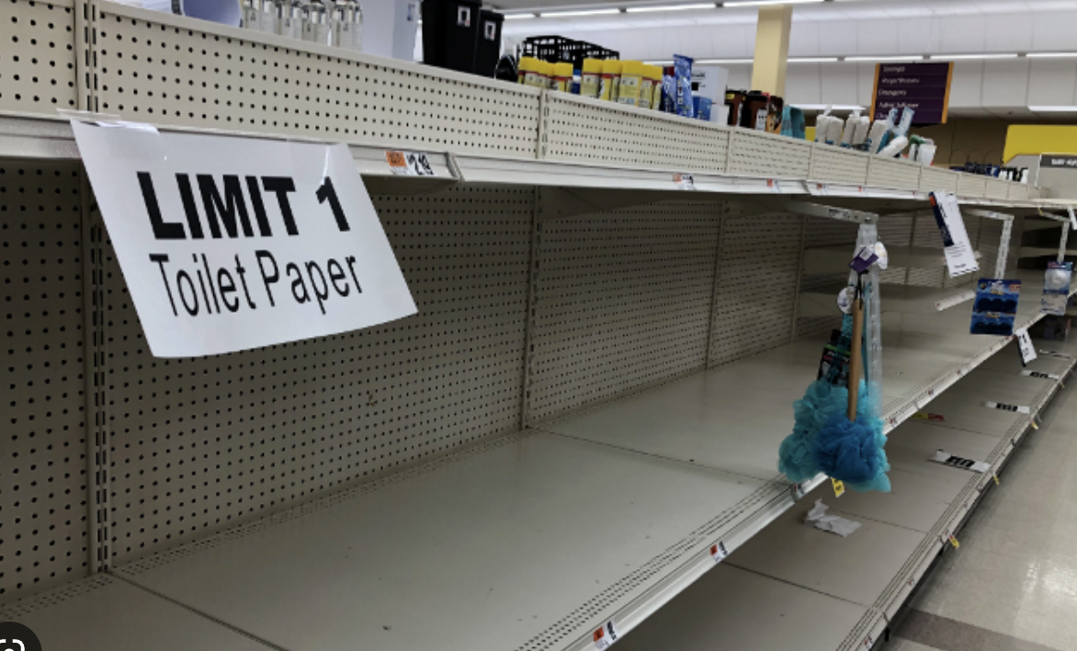
How did this get fixed?

Slide 13
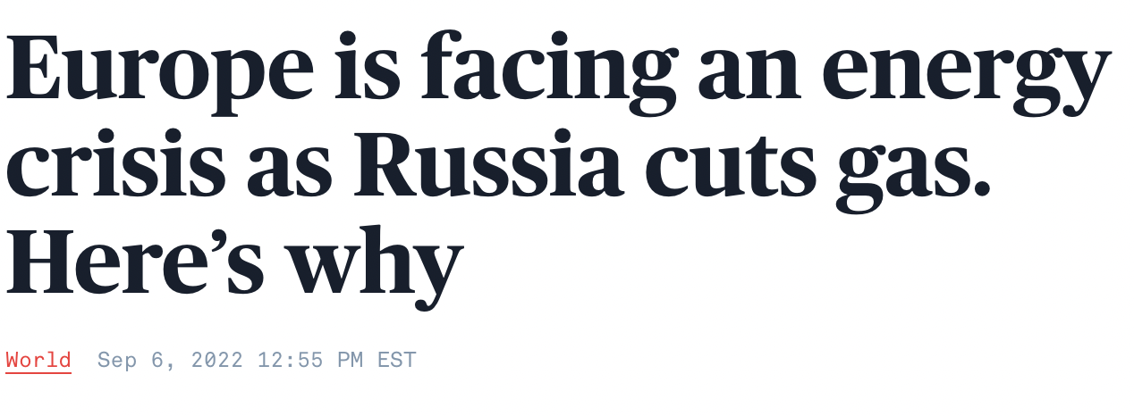
Or this?

Slide 14


Equilibrium of a Perfectly Competitive Market
What is the equilibrium of a perfectly competitive market?

Slide 15


Equilibrium of a Perfectly Competitive Market

Slide 16
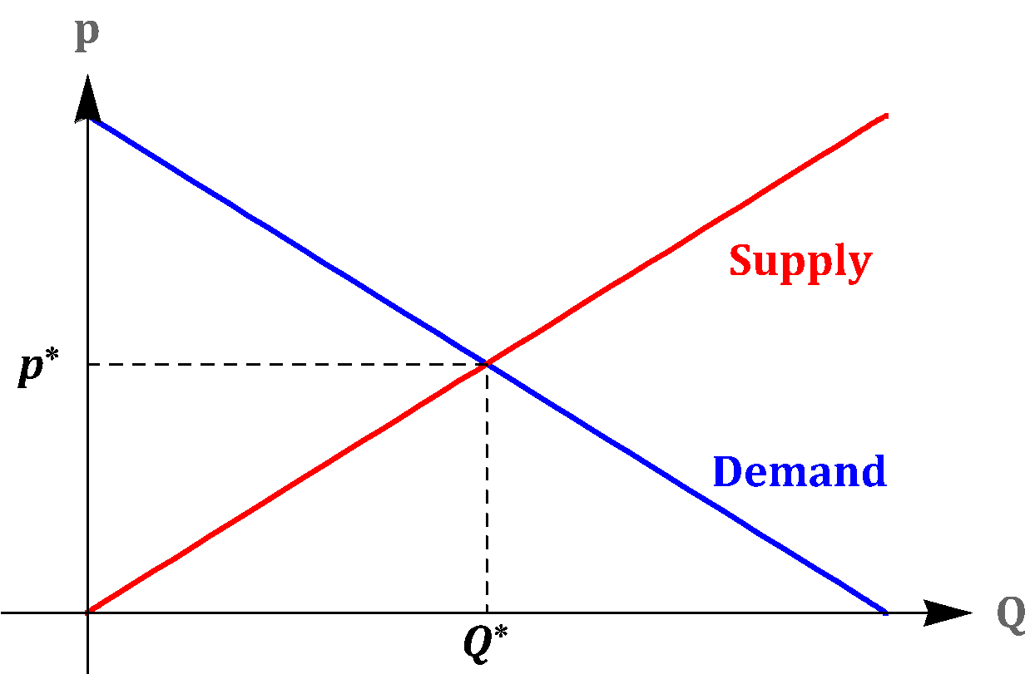
Equilibrium of a Perfectly Competitive Market

Slide 17
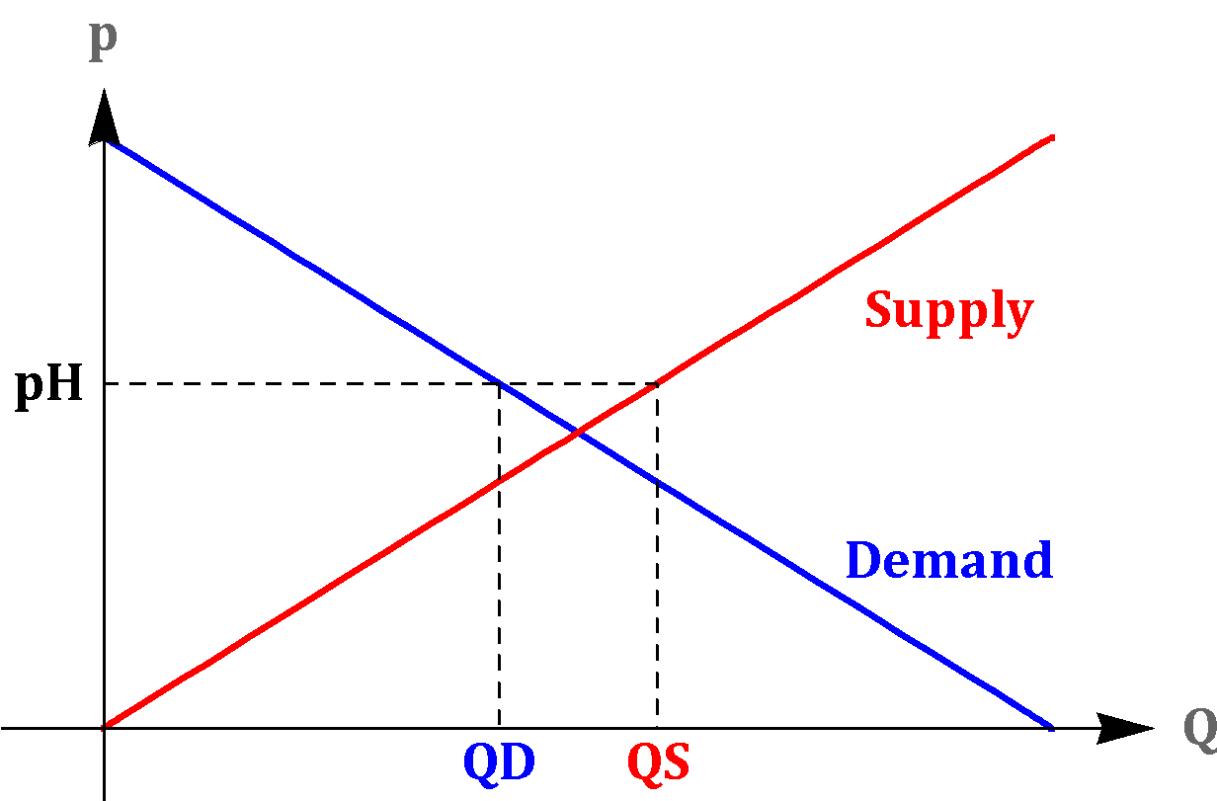
Excess Supply

Slide 18
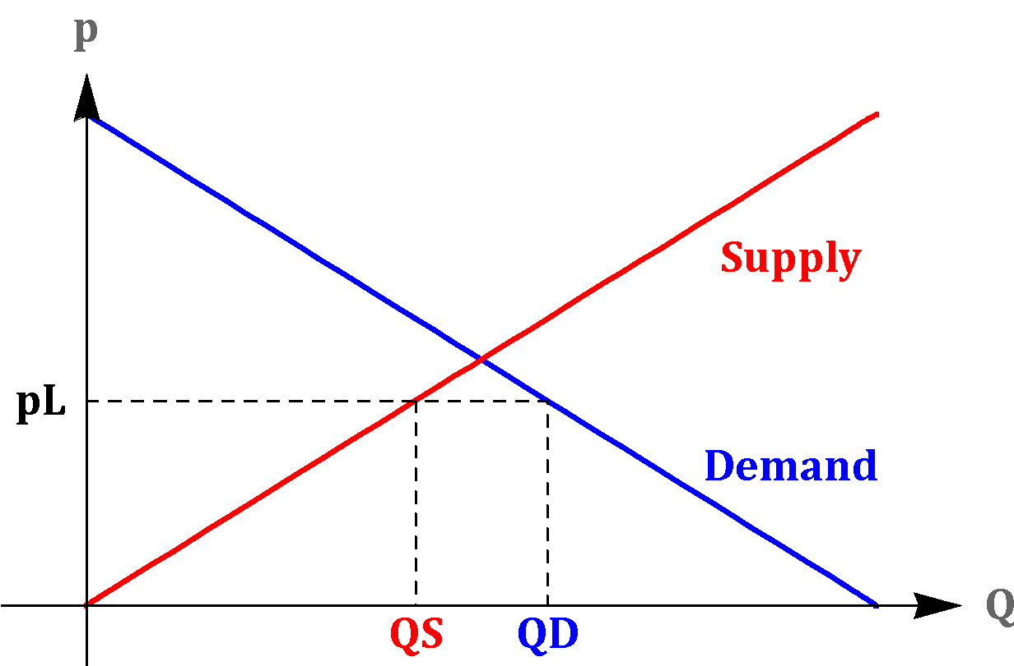
Excess Demand

Slide 19
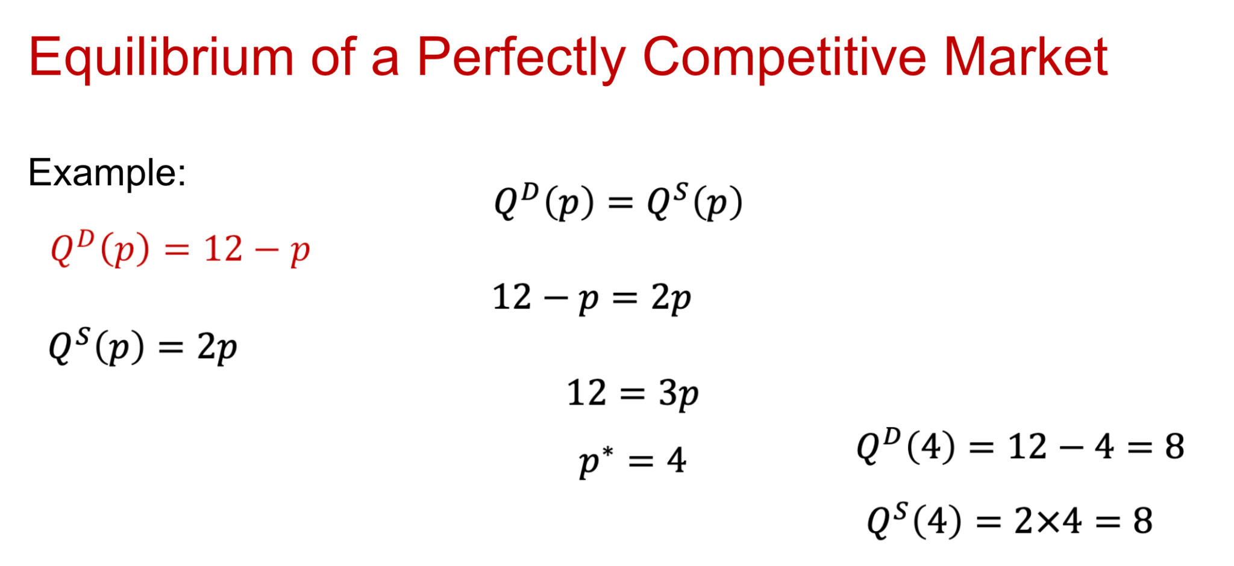

Slide 20
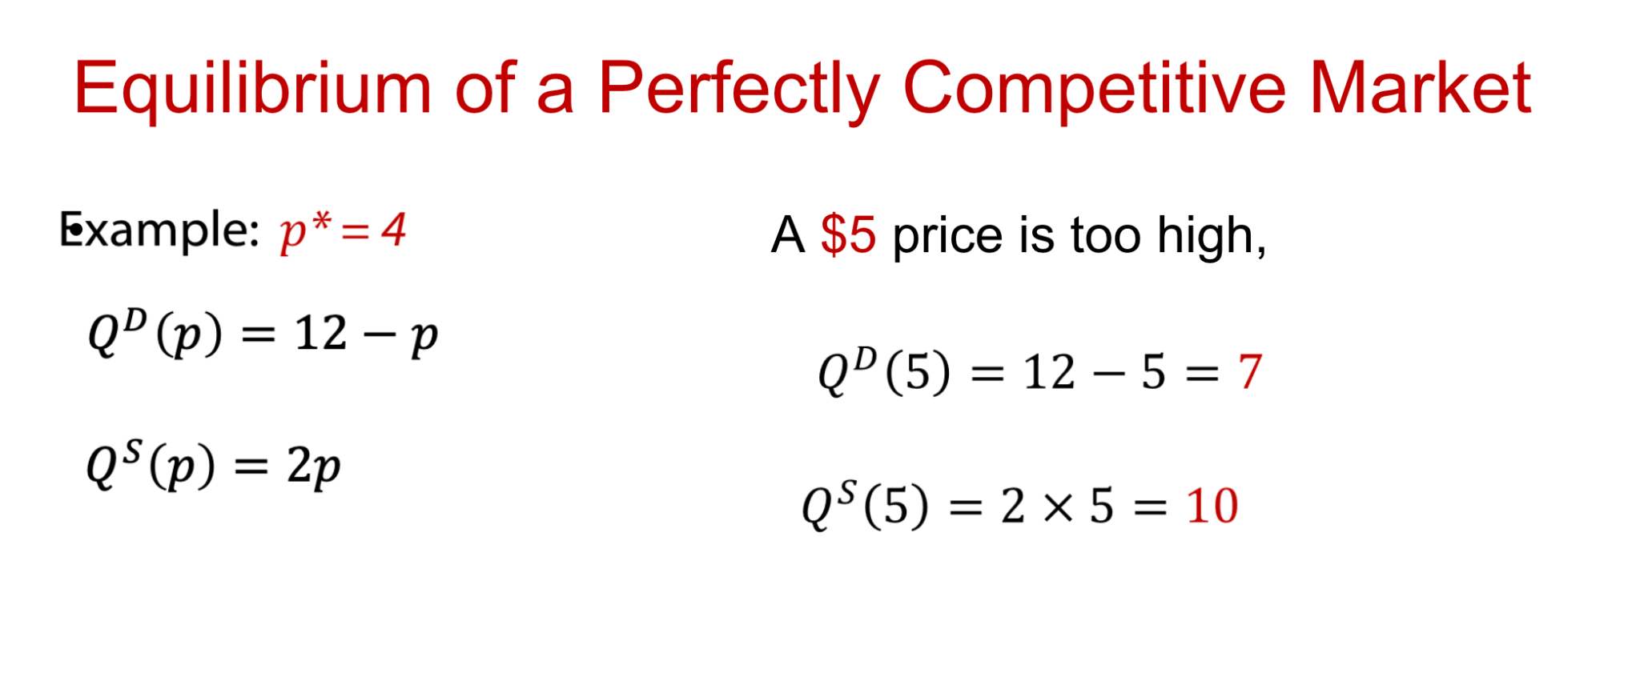

Slide 21
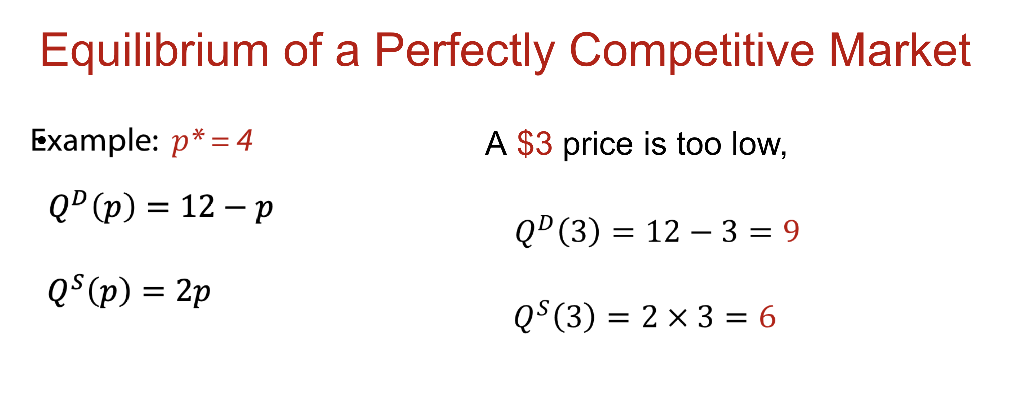

Slide 22
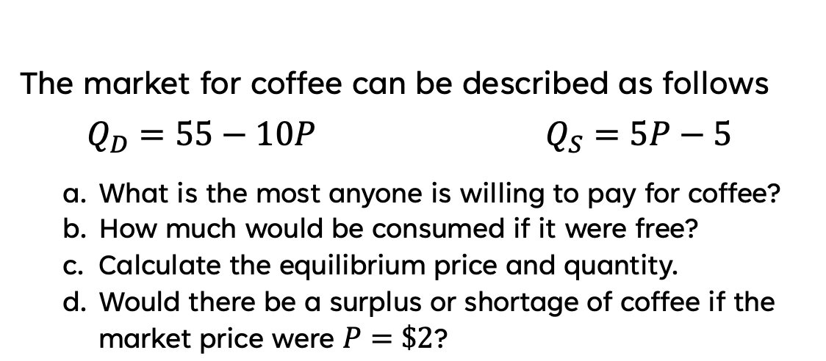
Problem
What is the equilibrium price and quantity?
What would happen if the price was $2? Shortage? Surplus? By how many units?

Slide 23
Changes in the Equilibrium
What were the Demand shifters?
What were the Supply shifters?

Slide 24
Changes in Equilibrium (Demand)
Demand Shifters
Income
# of buyers
Tastes
Price of related goods
Expectations
IMPORTANT NOTE:
Price changes move us along existing demand curve

Slide 25
Changes in Equilibrium (Supply)
Supply Shifters
# of sellers
Input Prices
Technology
Expectations
IMPORTANT NOTE:
Price changes move us along existing Supply curve

Slide 26
Changes in Equilibrium
Analysis
Event happens
Affect supply or demand?
Shift curve
Find new equilibrium (price and quantity)

Slide 27

Changes in Equilibrium
https://practice.mru.org/equilibrium/

Slide 28
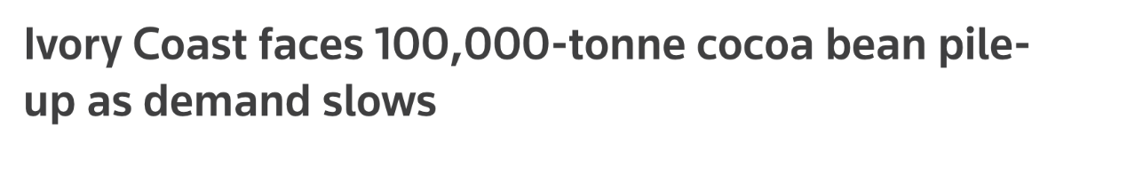
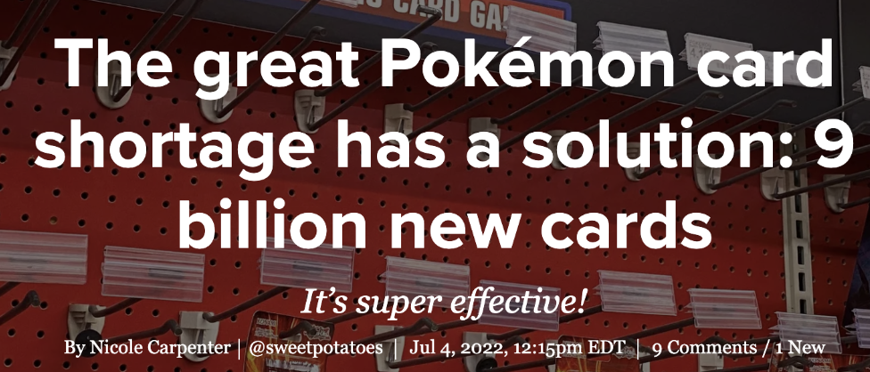
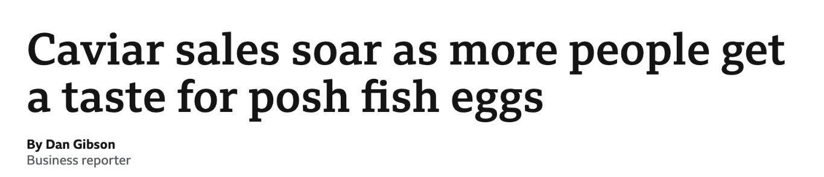
Model the Headline
1.
2.
3.

Slide 29
Shifts in both curves

Slide 30
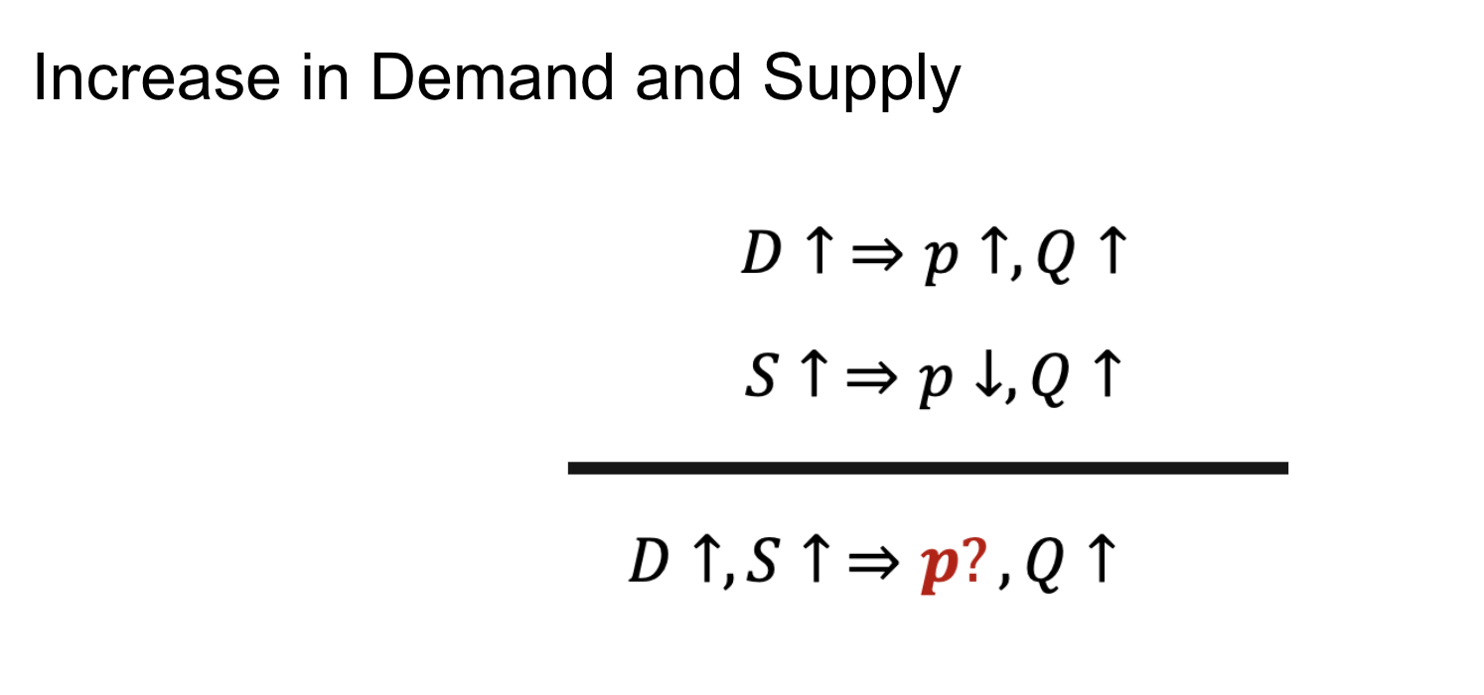

Slide 31
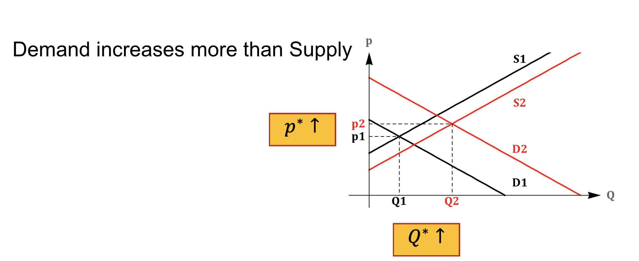

Slide 32
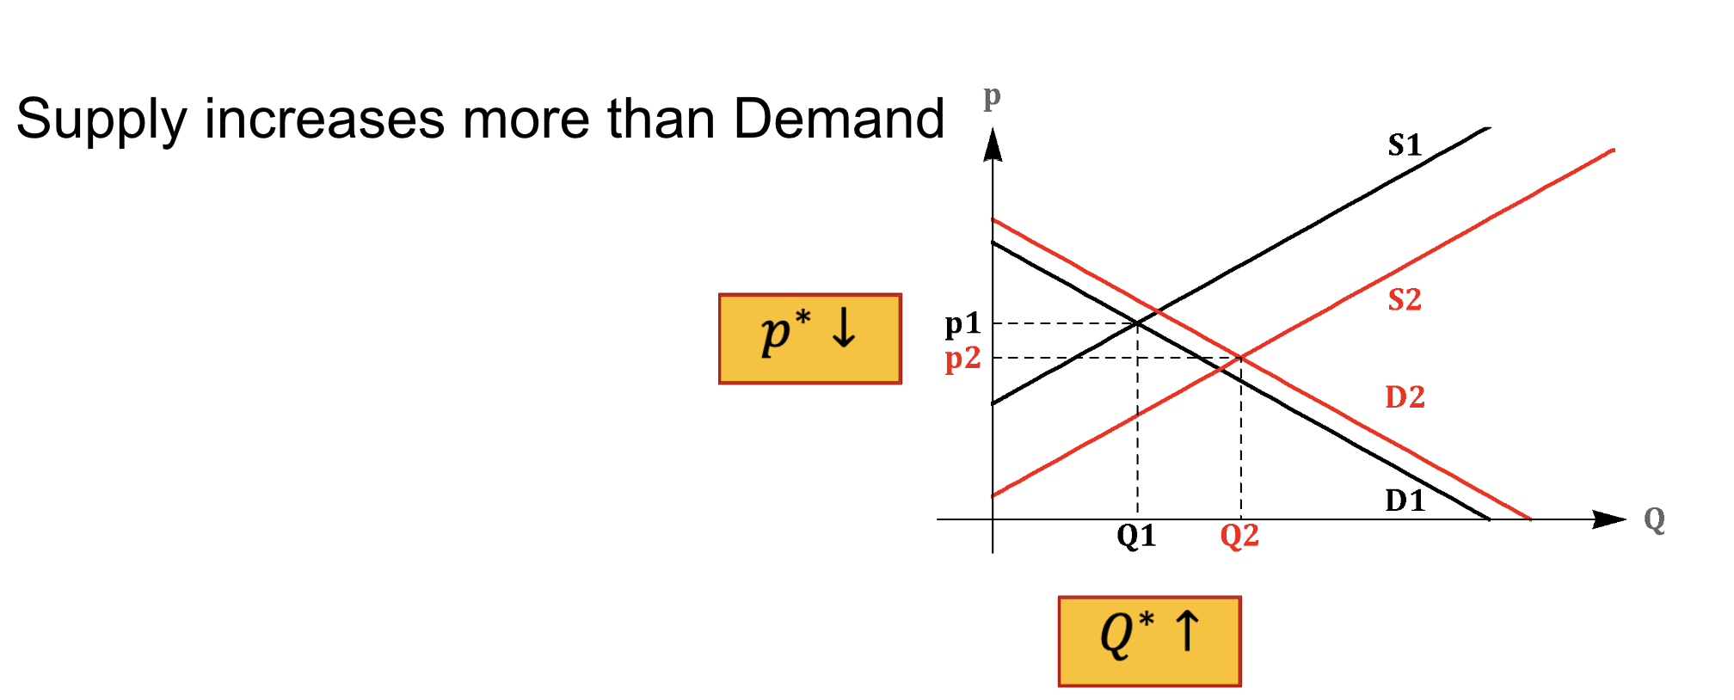

Slide 33
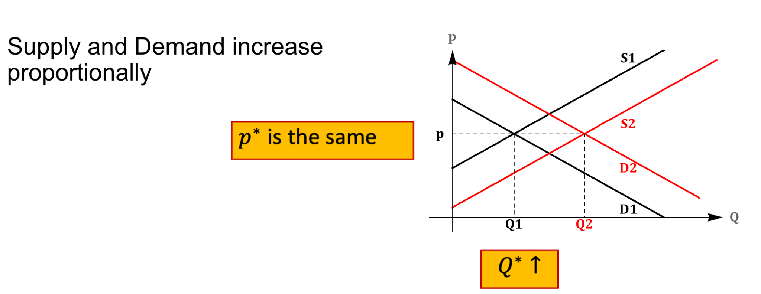

Slide 34
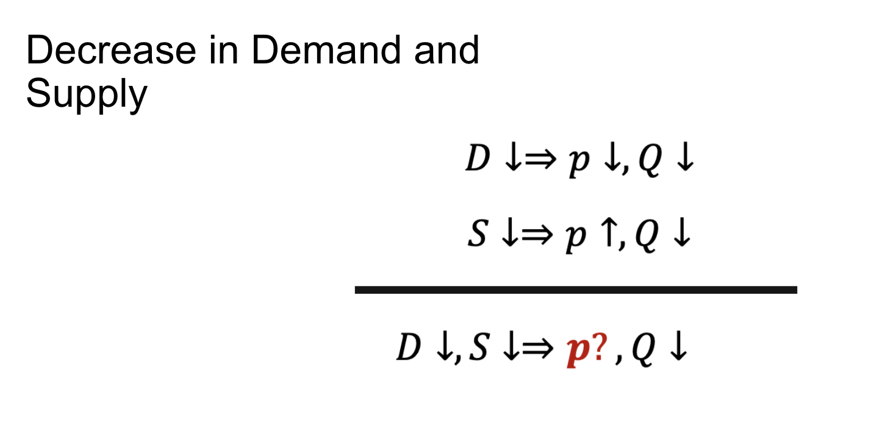

Slide 35
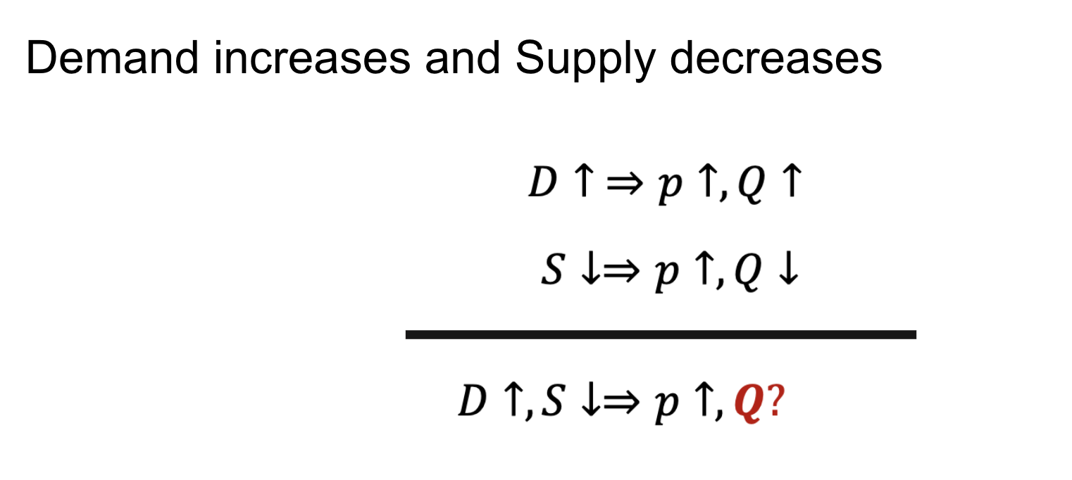

Slide 36
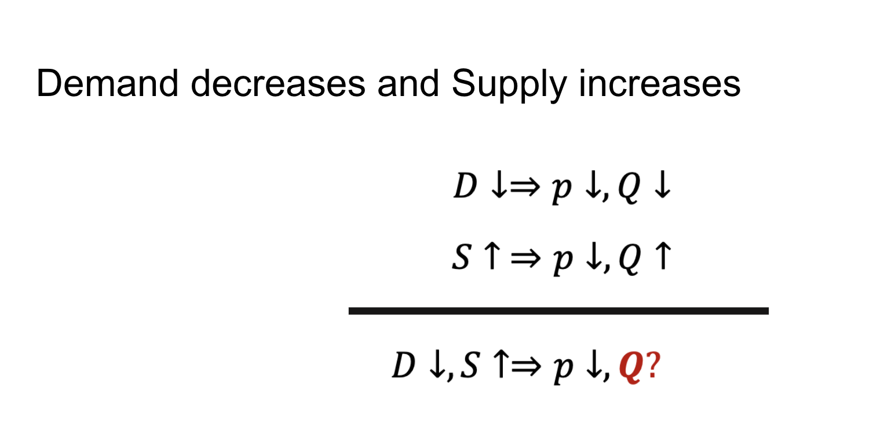

Slide 37
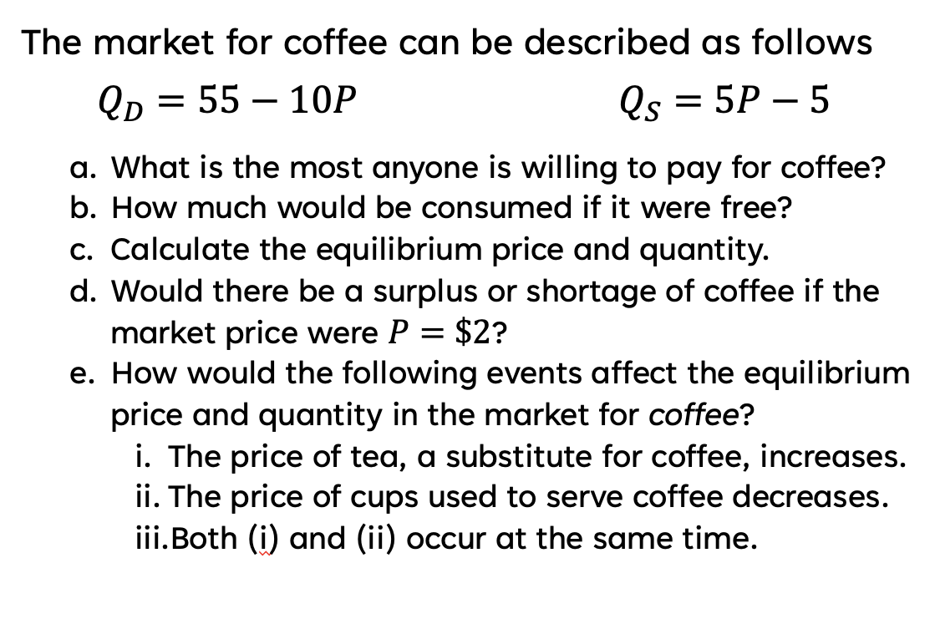
What would happen if
Tea (a substitute for coffee) went down in price
If coffee beans went up in price
If 1 & 2 happened together?

Slide 38

How did this get fixed?

Slide 39
Or this?

Slide 40
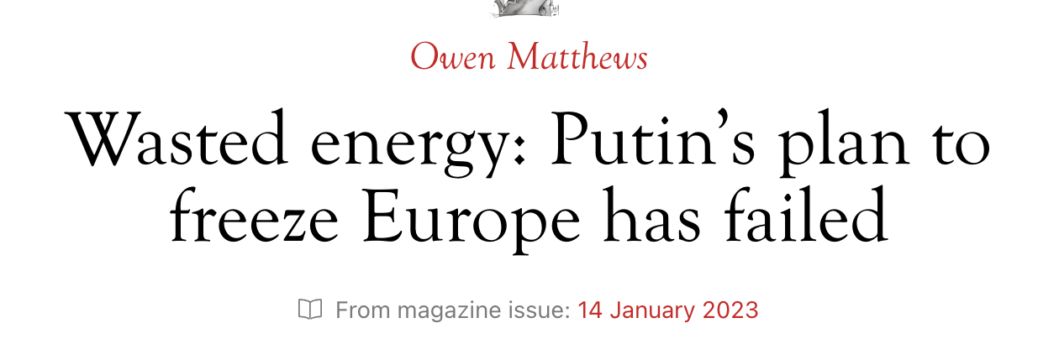
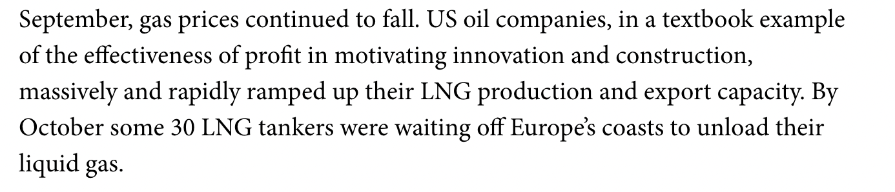

Slide 41
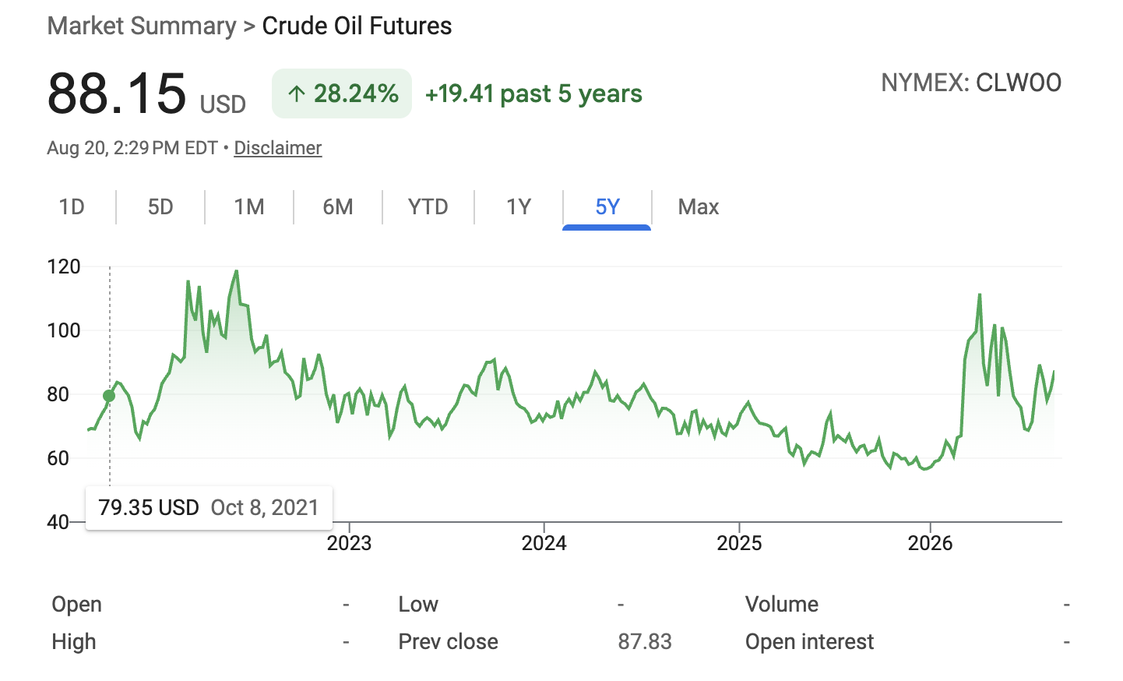
PRICE OF OIL
Source: https://www.macrotrends.net/1369/crude-oil-price-history-chart#google_vignette

Slide 42
Prices contain immeasurable information
https://www.youtube.com/watch?v=AEv9AszJ4_U

Slide 43
Markets drive Innovation

Slide 44


What has growth looked like?

Slide 45
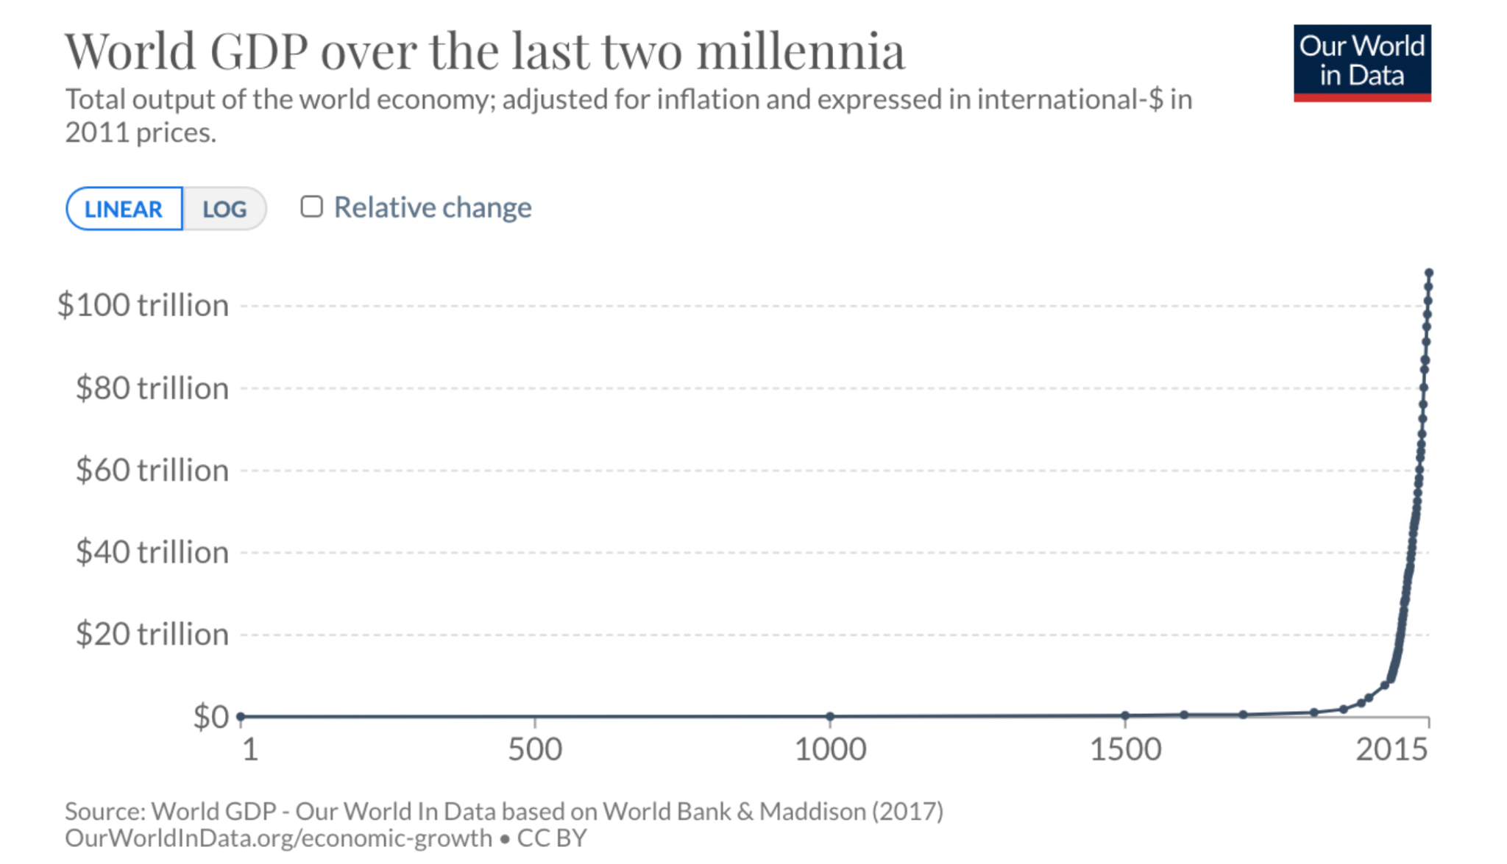

Slide 46
“Throughout history, poverty is the normal condition of (humans). Advances which permit this norm to be exceeded are the work of an extremely small minority, frequently despised, often condemned, and almost always opposed by all right-thinking people. Whenever this tiny minority is kept from creating, or is driven out of a society, the people then slip back into abject poverty.
This is known as "bad luck.”
Robert Heinlein
“If you are a technologist working on some new, clean, abundant form of energy, I wish you all the luck in the world. But you must not labor under the illusion that should you succeed, your efforts will be justly rewarded by the gratitude of the people you have lifted from poverty and enabled to have a bright and growing future. You will be attacked, your work will be lied about by activists, demonized by ignorant journalists, and strangled by regulation.
But only if it works.”
J. Storrs Hall

Slide 47
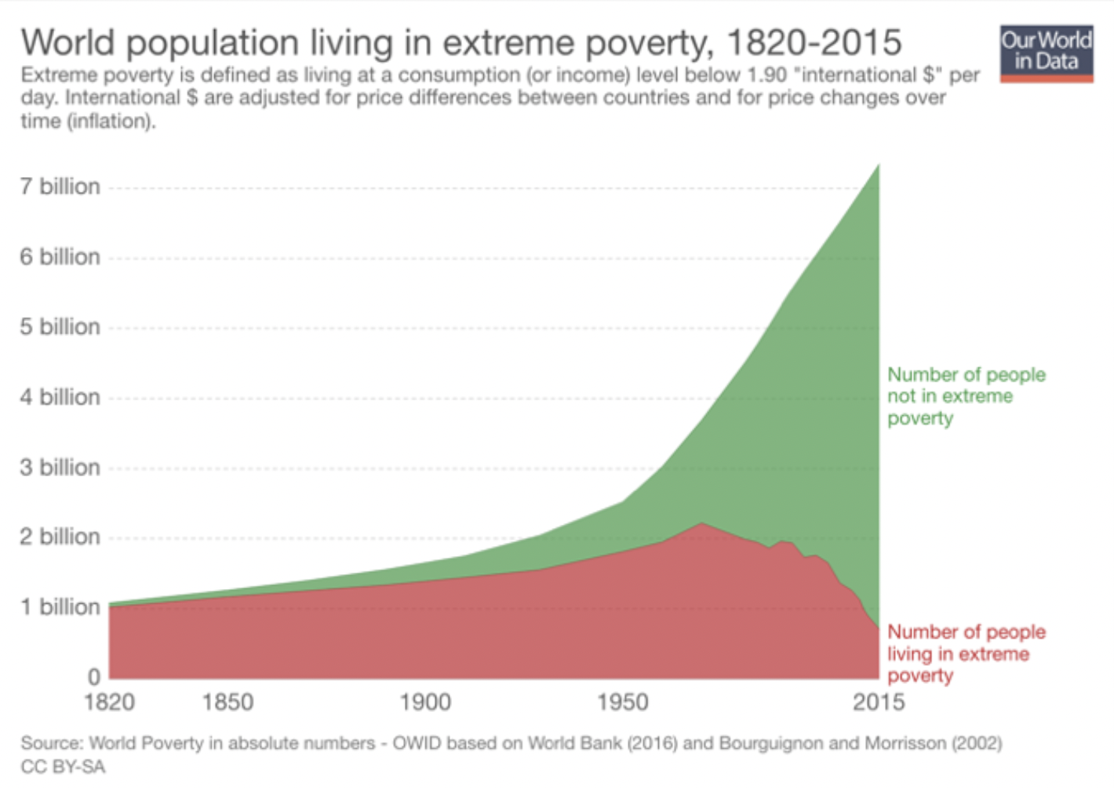

Slide 48
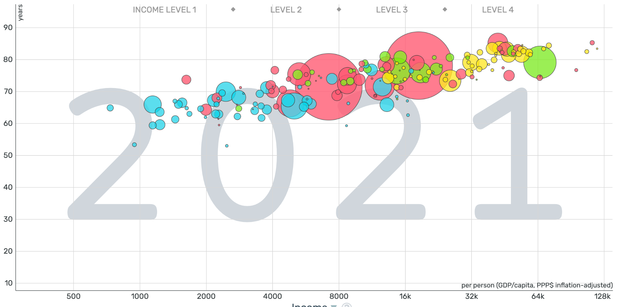

Slide 49
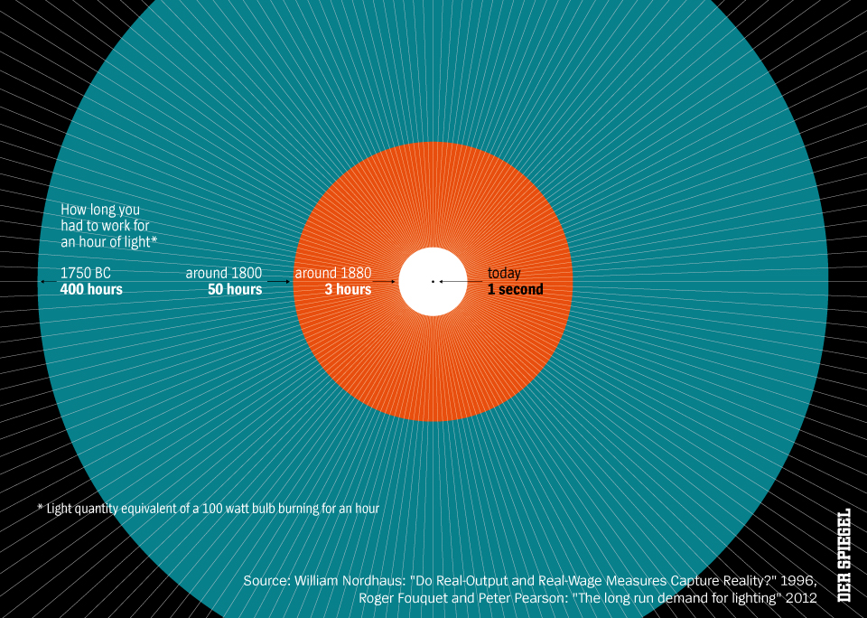


Slide 50
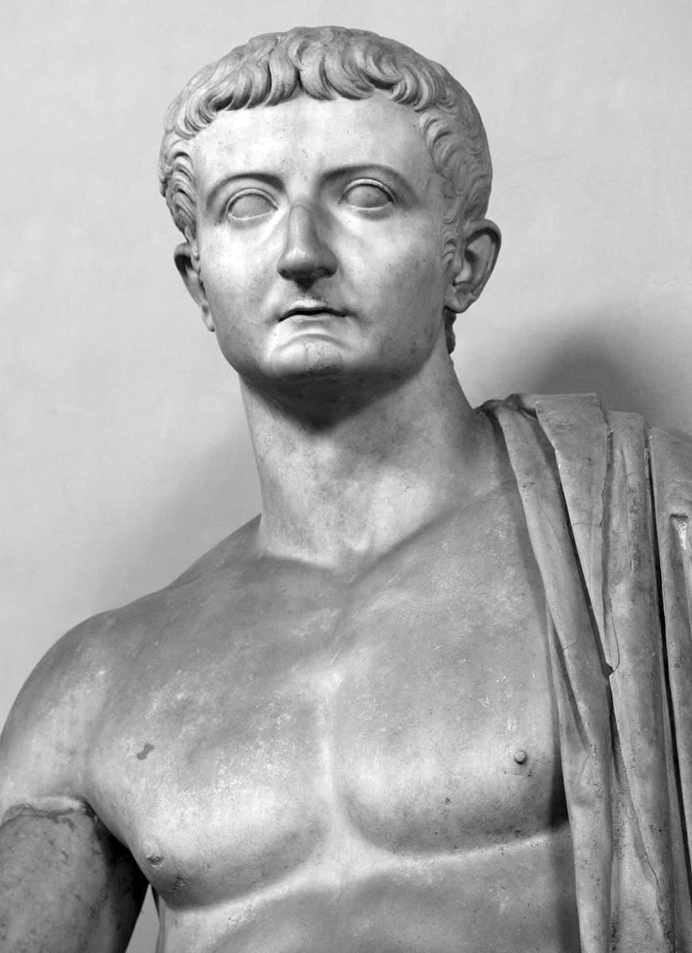
The year is sometime between
14 and 37, in the Roman Empire.
An inventor comes up with unbreakable flexible glass
and presents it to Emperor Tiberius.
What happened to the inventor?

Slide 51

Death!
The emperor had the inventor killed to protect glass makers.

Slide 52
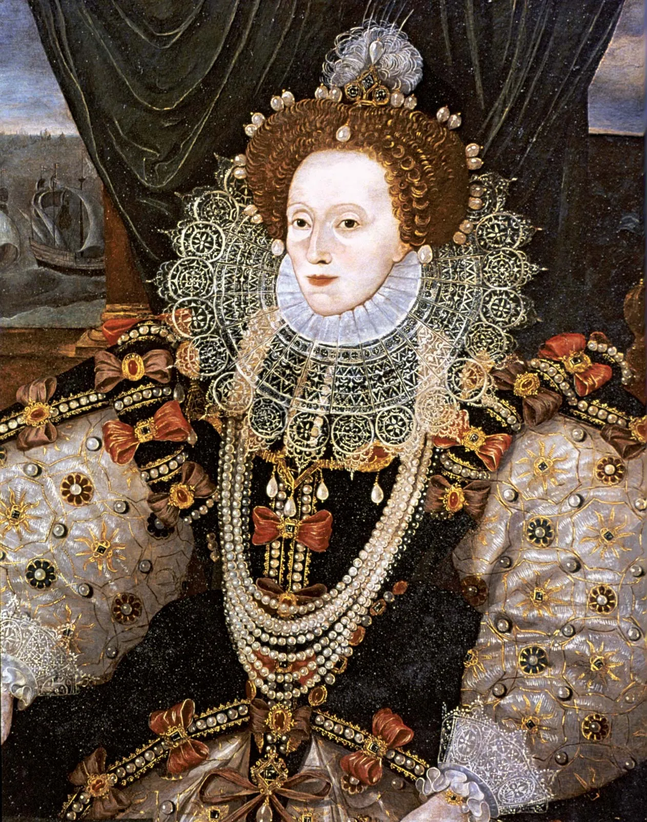
The year is 1589. William Lee presents his new knitting machine to Queen Elizabeth of England.
What happened to William Lee?

Slide 53
Not Death! Just rejection.
The Queen denied his request for a patent and for funds to develop it further.

Slide 54
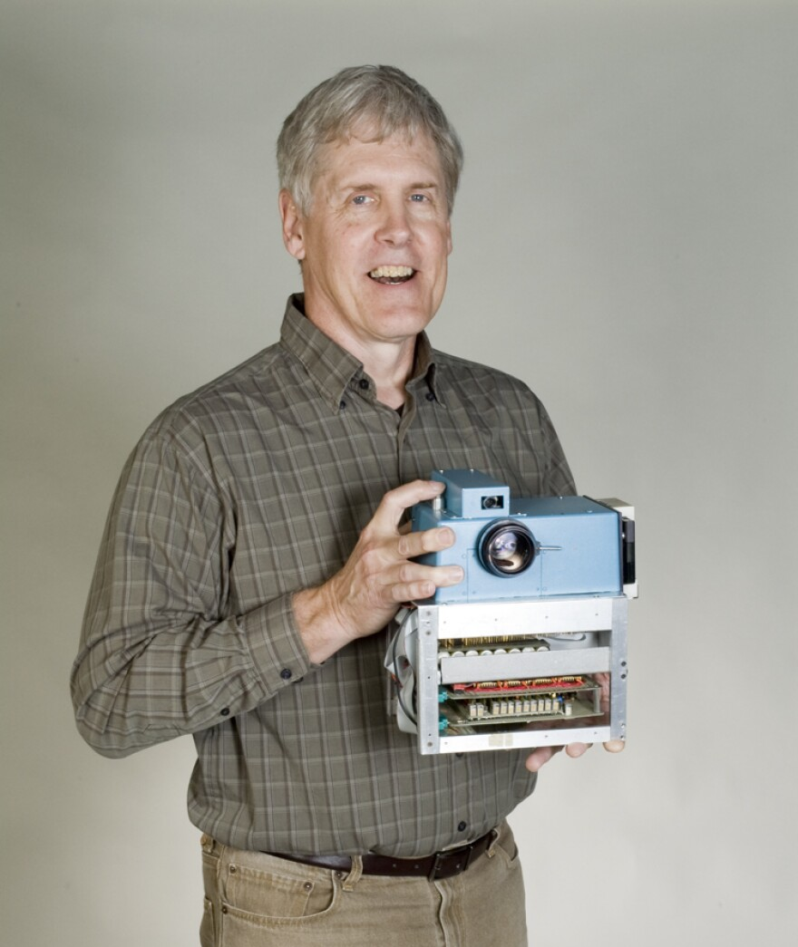
It is 1975. An engineer at
Kodak (Steve Sasson) invents the digital camera.
What happened next?

Slide 55
Not death, and not rejection!
Steve Sasson remained at Kodak until his retirement. But Kodak failed to develop the digital camera as a viable product (they feared the invention would eat into its film camera business).
Other companies came to dominate the digital camera business instead of Kodak.

Slide 56
Innovation
All truth passes through three stages:
First, it is ridiculed.
Second, it is violently opposed.
Third, it is accepted as self-evident.

Slide 57
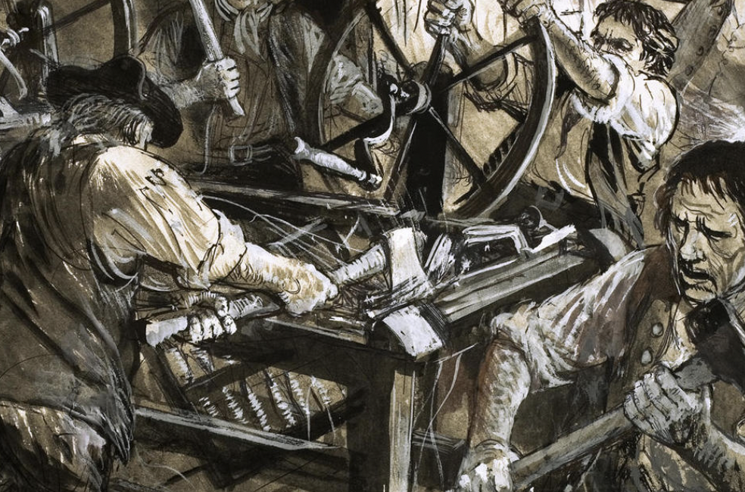

Slide 58


Slide 59
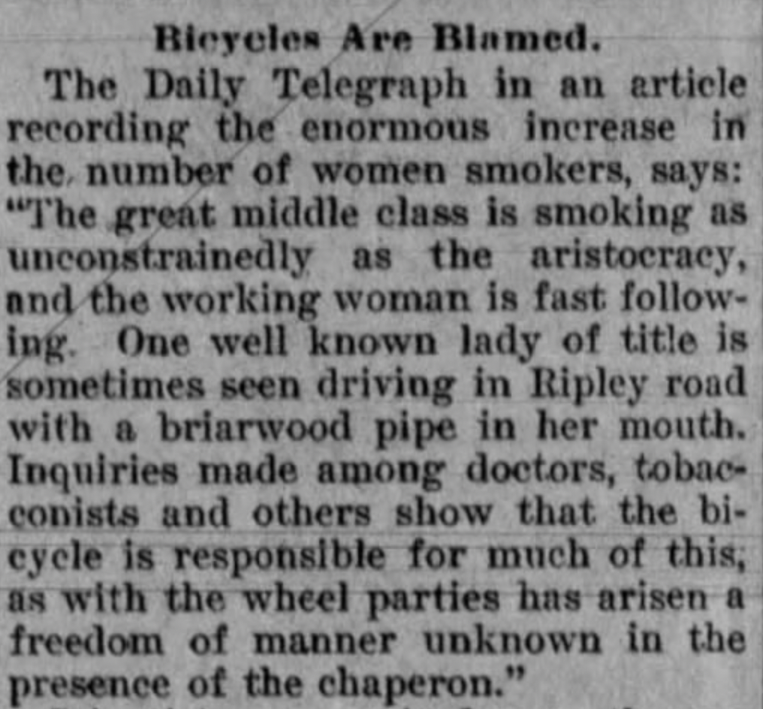
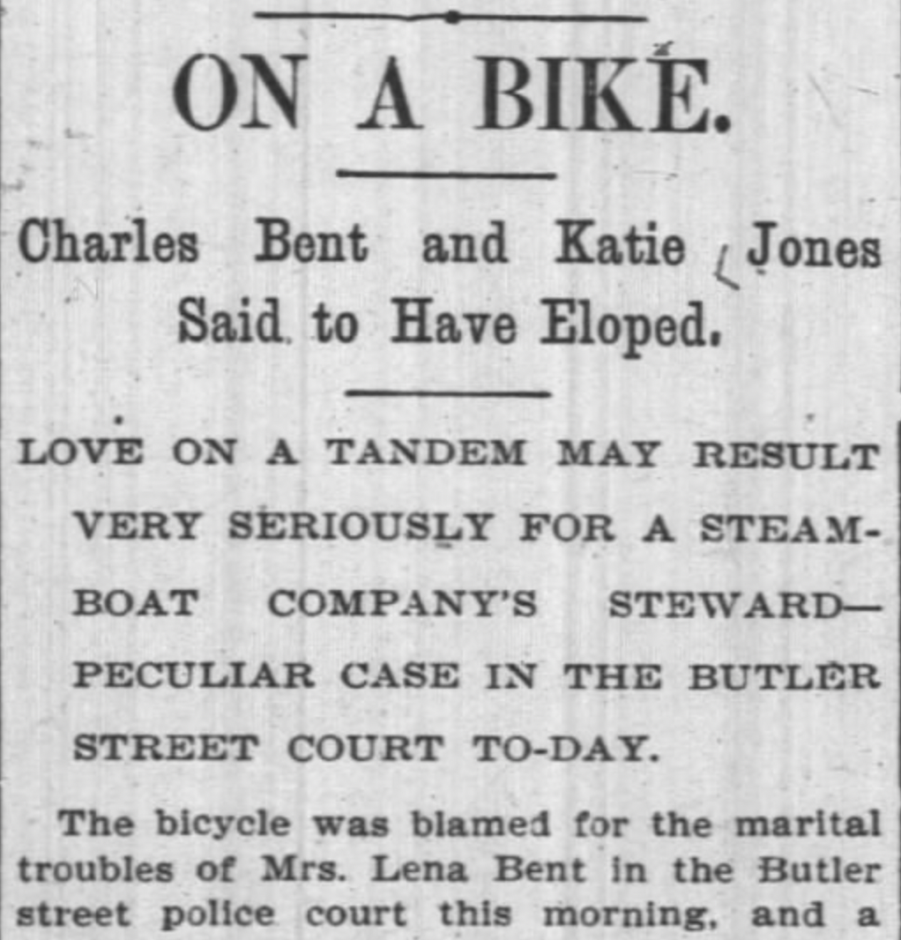
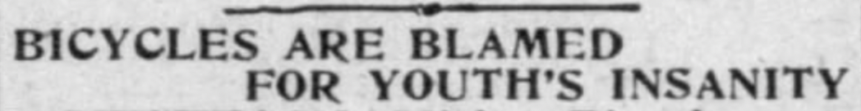
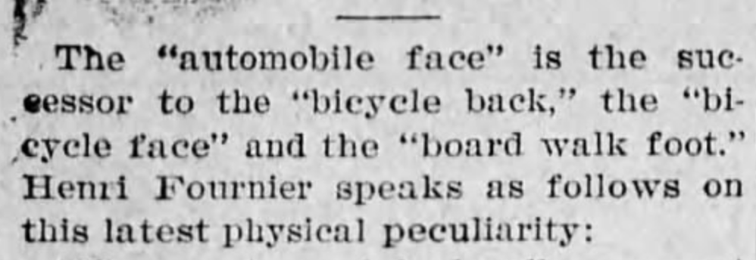

Slide 60
Markets and Innovation
Markets as a way to find “useful” truths
Innovation/invention always disrupt status quo, hence the resistance
Markets as a way for innovators to go directly to consumer without need for approval
Markets let people decide what is valuable to them, and end around entrenched political/economic interests
Very few examples of innovation without a market

Slide 61
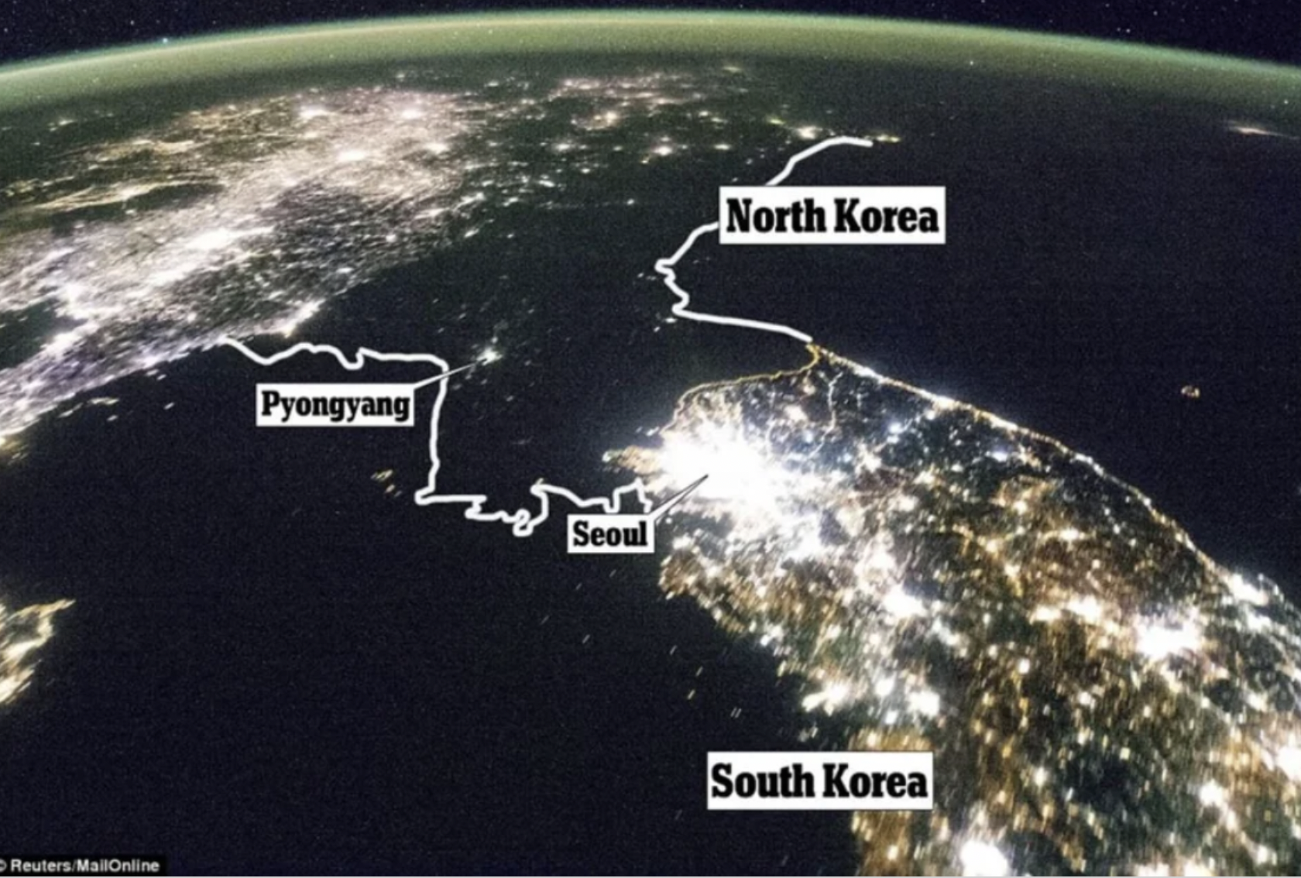

Slide 62
Markets make Win-Wins normal

Slide 63
Markets make Win-Wins normal
Efficiency is defined as the maximization of total surplus = consumer surplus + producer surplus

Slide 64
Consumer Surplus
Every time you buy something your REVEALED PREFERENCE is I would have paid more for this
The most you’d be willing to pay is your willingness to pay (WTP)
How much better off are you every time you buy something
WTP - PRICE

Slide 65
Individual Consumer Surplus
Individual Consumer Surplus:
(The highest they would have paid) minus (what they paid)
Willingness to pay - Price
Or
How much they value the good - Price

Slide 66
ECON LIFE HACK
Practice calculating your consumer surplus when you buy something and realize how much better off you are.

Slide 67
CS Questions
I buy a sweater, the sweater cost $45, and I would have paid $80.
What is the total consumer surplus generated by this exchange?
https://youtu.be/D5VvcnQ5LiE

Slide 68
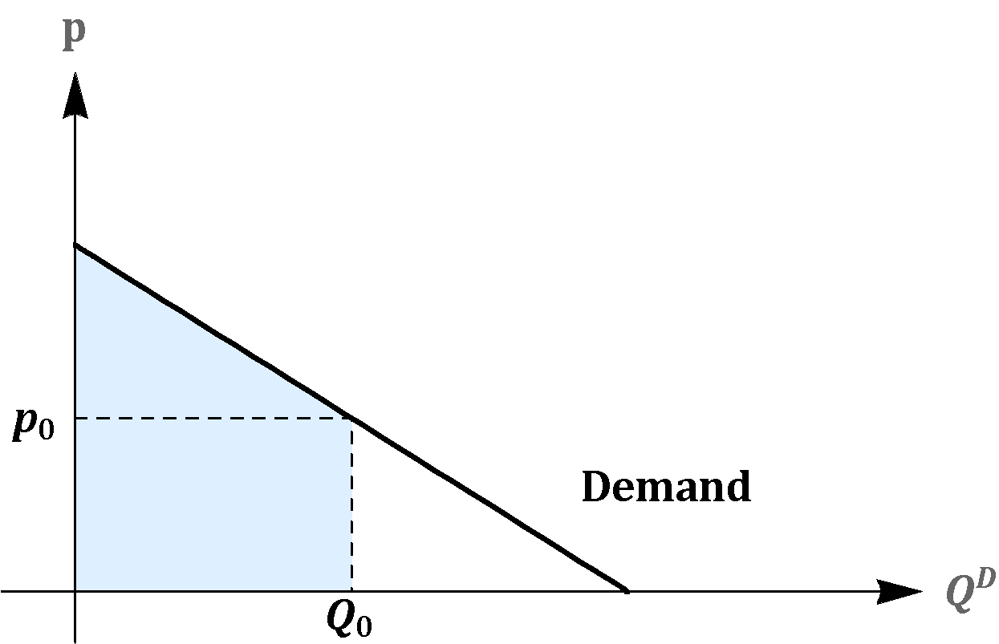
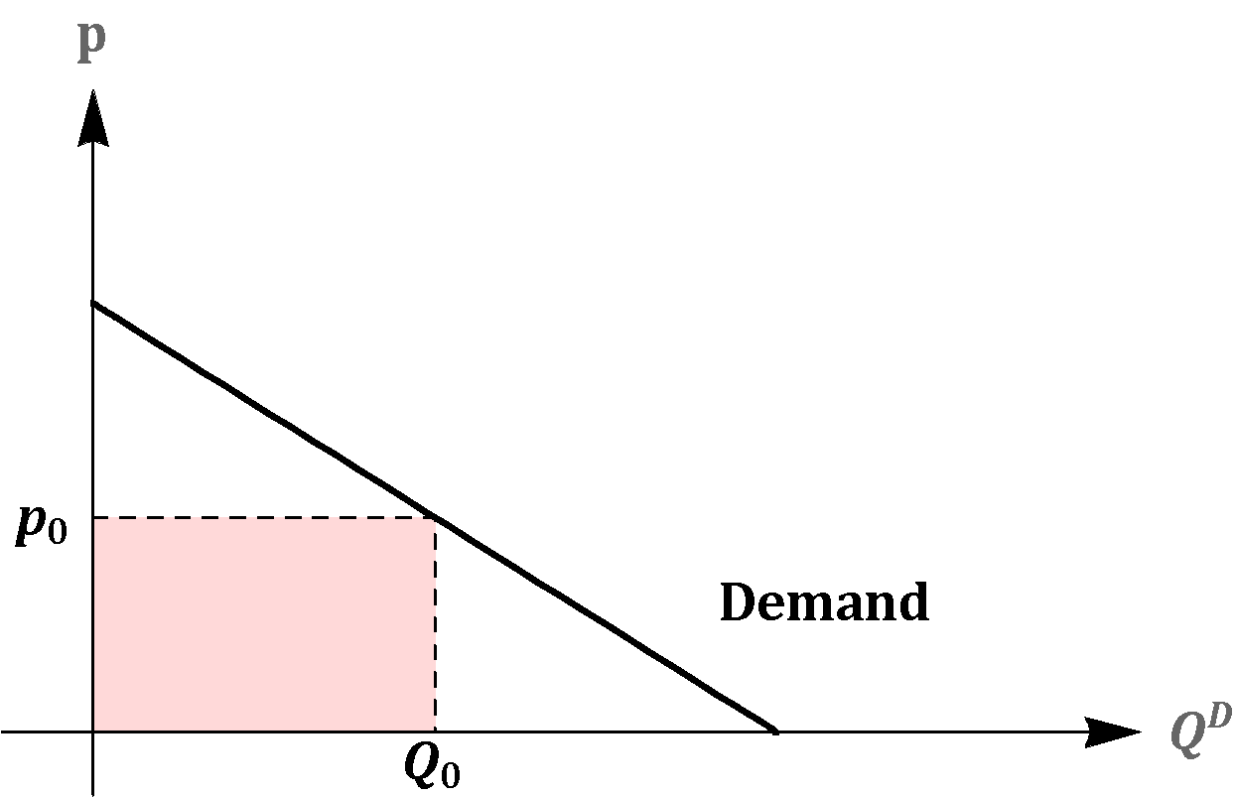
Consumer Surplus - Market Level Analysis
Total Value = 500
Expenditure = 200

Slide 69
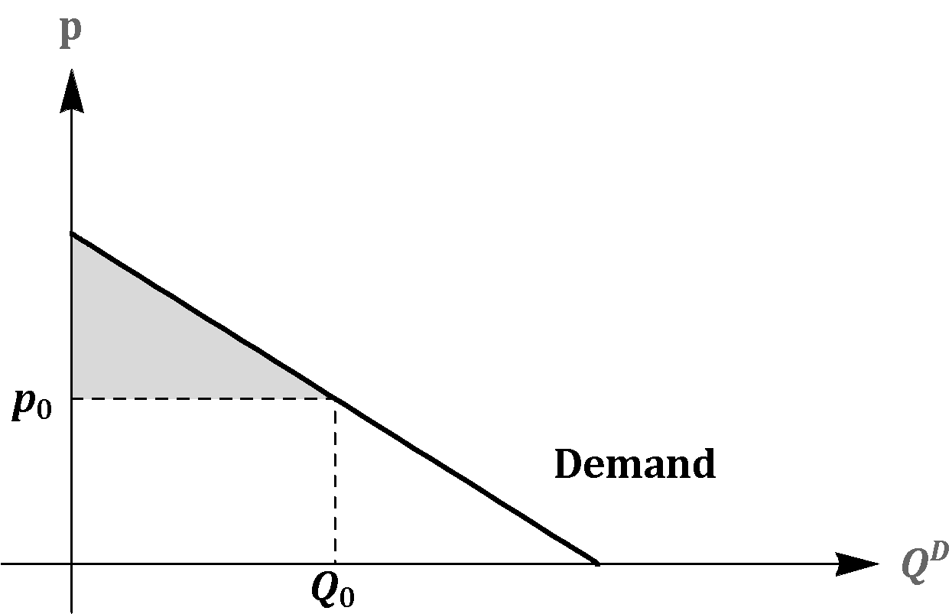
Consumer Surplus
Consumer Surplus = Total Value - Expenditure
Consumer Surplus = 500 - 200 = 300
Consumer Surplus

Slide 70
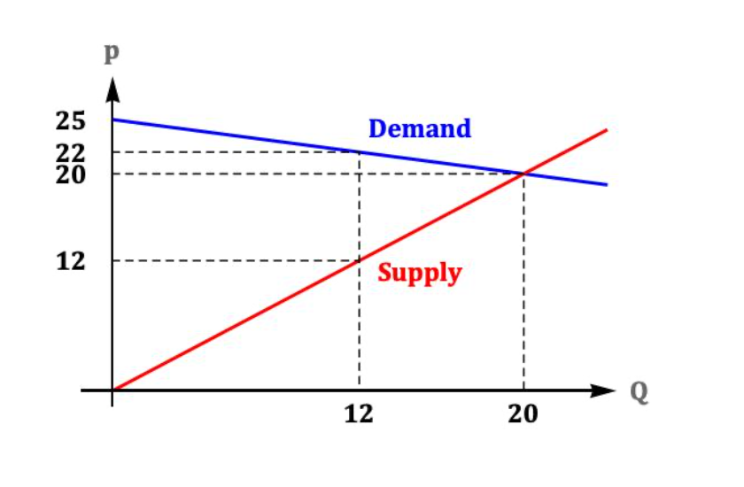
What is consumer surplus in this market when P=20, P=22 and P=25?

Slide 71
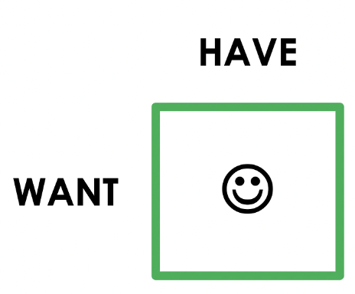
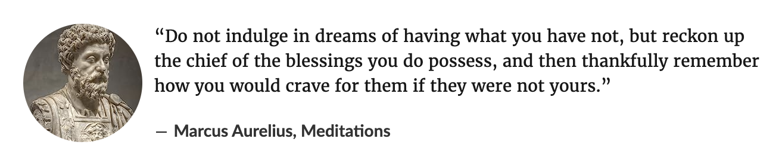
Marcus Aurelius appreciates Consumer Surplus

Slide 72
Consumers win in Markets
They only buy things that they value MORE than the price
But producers also win!

Slide 73
Cost and the Supply Curve
Cost is the value of everything a seller must give up to produce a good (including opportunity cost).
Cost of all resources used to produce good, including value of the seller’s time.
Example: Costs of 3 sellers in the lawn-cutting business.
name | cost
Jack | $10
Janet | 20
Chrissy | 35
A seller will produce and sell the good/service only if the price exceeds his or her cost.
Hence, cost is a measure of willingness to sell.
Notes:
‹#›
The material on cost, producer surplus, and the supply curve is analogous to the material earlier on WTP, consumer surplus, and the demand curve. Therefore, this section provides a bit less detail and should move a little more quickly.

Slide 74
Producer Surplus
PS = P – cost
Notes:
‹#›

Slide 75
Producer Surplus and the S Curve
PS = P – cost
Suppose P = $25.
Jack’s PS = 25 - 10 = $15
Janet’s PS = 25 – 20 = $5
Chrissy’s PS = $0
Total PS = $20
name | cost
Jack | $10
Janet | 20
Chrissy | 35
Notes:
‹#›

Slide 76
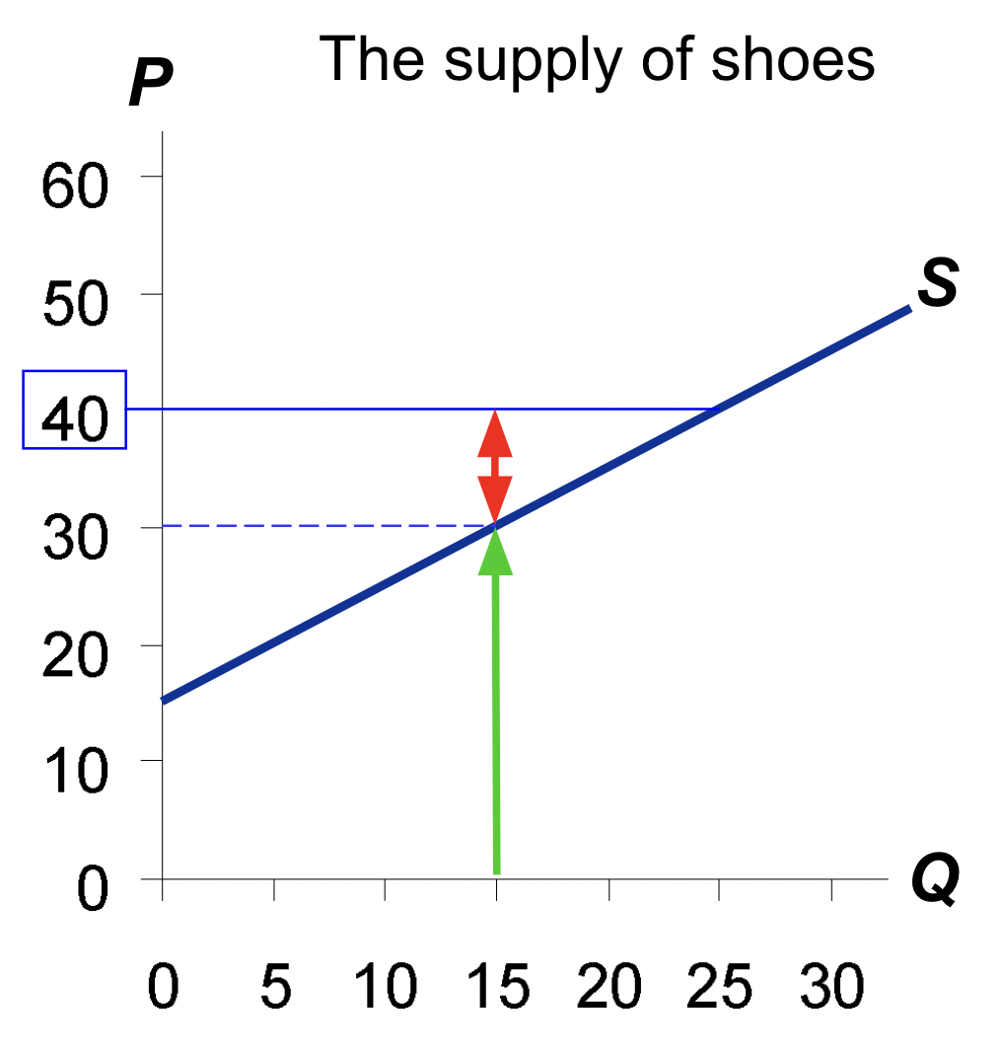
PS with Lots of Sellers & a Smooth S Curve
Suppose P = $40.
At Q = 15(thousand), the marginal seller’s cost is $30,
and her producer surplus is $10.
Notes:
‹#›

Slide 77
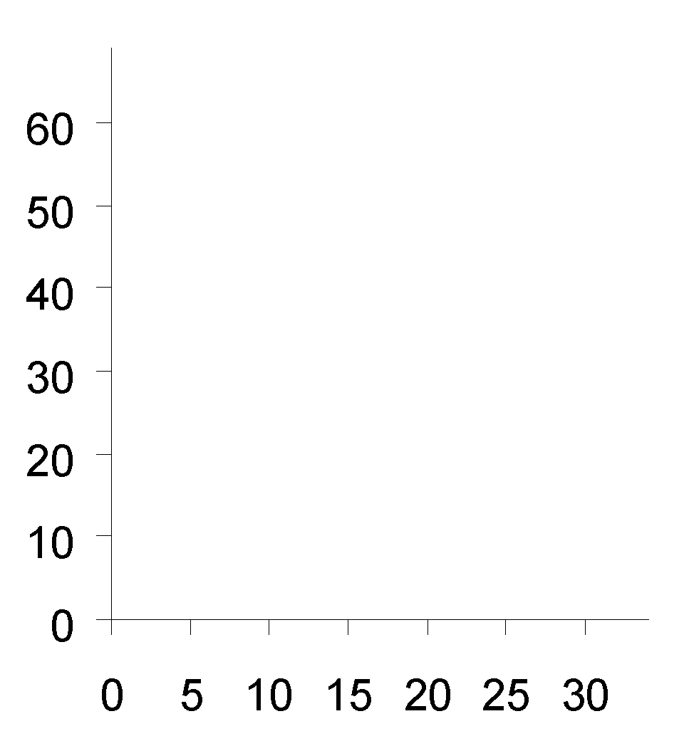
PS with Lots of Sellers & a Smooth S Curve
PS is the area b/w
P and the S curve, from 0 to Q.
The height of this triangle is
$40 – 15 = $25.
So,
PS = ½ x b x h
= ½ x 25 x $25
= $312.50
The supply of shoes
P
S
h
Q
Notes:
‹#›

Slide 78
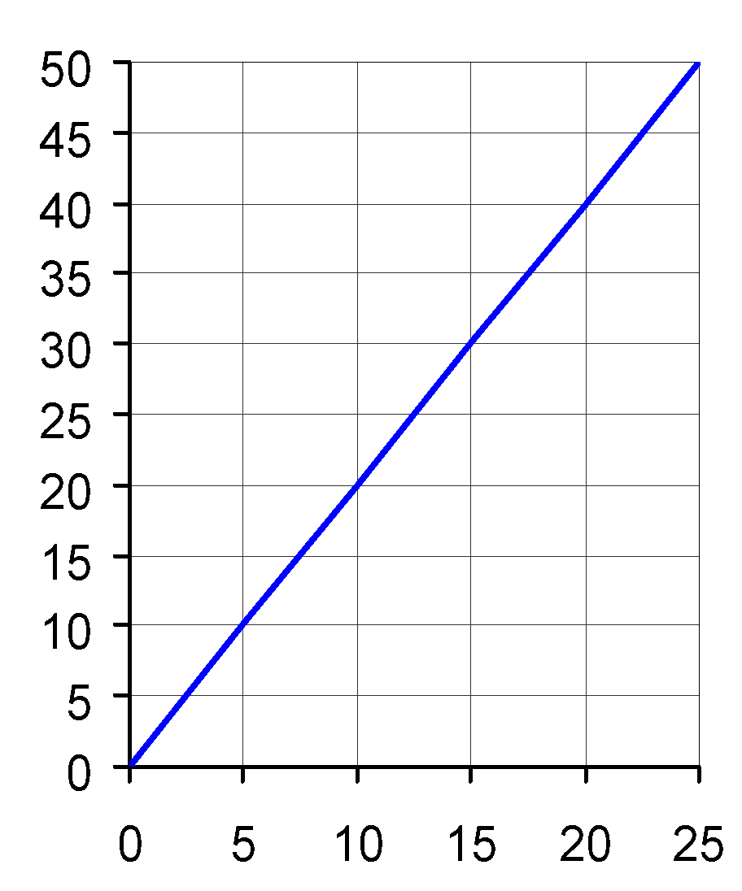
supply curve
P
Find marginal
seller’s cost
at Q = 10.
Find total PS for
P = $20.
Suppose P rises to $30.
Find the increase
in PS:
Q
© 2015 Cengage Learning. All Rights Reserved. May not be copied, scanned, or duplicated, in whole or in part, except for use as permitted in a license distributed with a certain product or service or otherwise on a password-protected website for classroom use.

Slide 79
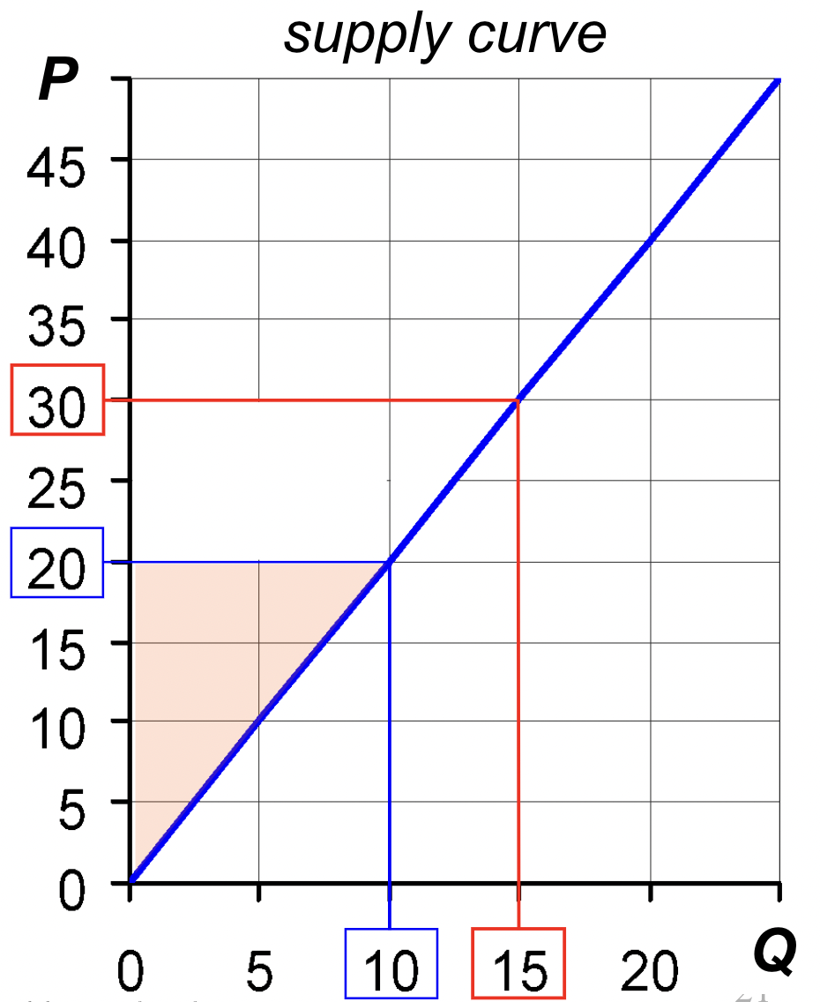
A. At Q = 10,
marginal cost = $20
B. PS = ½ x 10 x $20
= $100
P rises to $30.
C. $125 increase in PS
© 2015 Cengage Learning. All Rights Reserved. May not be copied, scanned, or duplicated, in whole or in part, except for use as permitted in a license distributed with a certain product or service or otherwise on a password-protected website for classroom use.

Slide 80
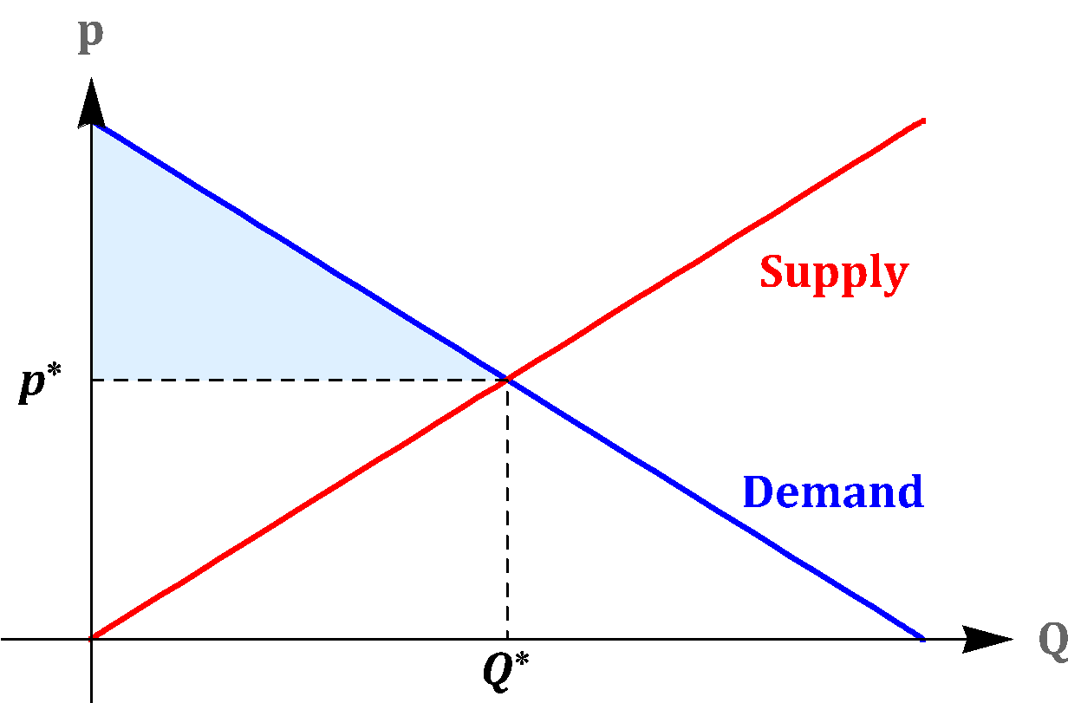
Efficiency: Consumer Welfare is Measured as Consumer Surplus

Slide 81
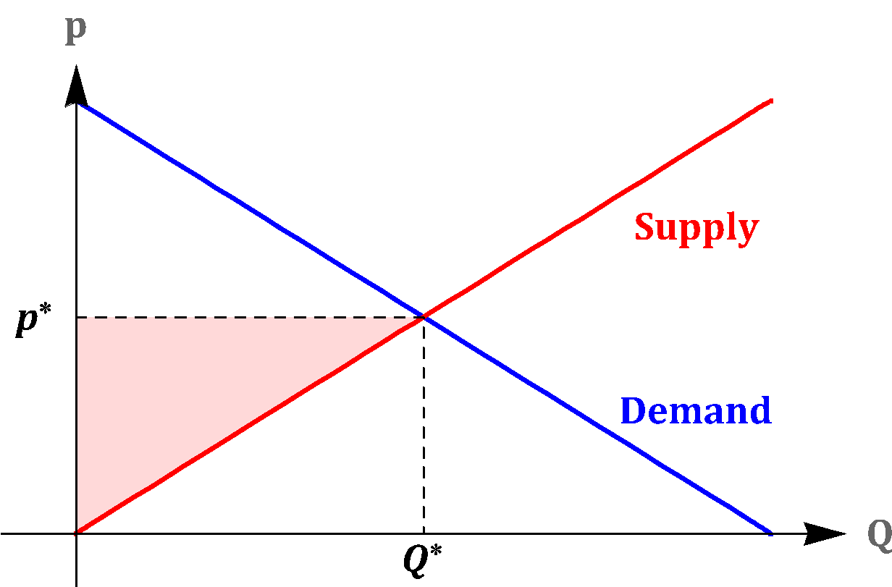
Efficiency: Producer Welfare is Measured as Producer Surplus

Slide 82
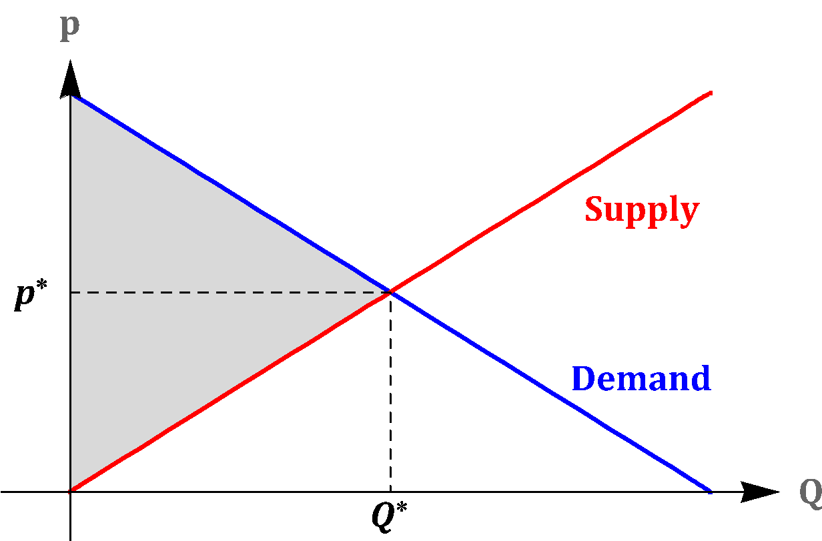
Efficiency: Total Welfare is Measured as the sum of Consumer and Producer Surplus
=
+
Total Surplus (TS) = Consumer Surplus (CS) + Producer Surplus (PS)

Slide 83
Total Surplus:
Equally treats CS and PS
Consumer and producer surplus are treated equally, because we do not want to make value judgements regarding the importance of consumer versus producer welfare.
Does not consider distribution.

Slide 84

Perfect Competition and Total Surplus

Slide 85

Perfect Competition and Total Surplus

Slide 86

Perfect Competition and Total Surplus

Slide 87
Consumer and Producer Surplus
Key: Consumers value the good at more than it costs producers to make it
Exchange creates surplus for both
Price determines the size of each’s surplus

Slide 88
Invisible Hand
In spite of the fact that each firm and each consumer is acting with an apparently selfish objective and the market operates without guidance or regulation by a central planning agency, market forces drive the equilibrium to be socially efficient.
The invisible hand of the price system in Adam Smith’s book (“The Wealth of Nations”) converts the self-interest of consumers and producers into a common good with very few information requirements.

Slide 89
Invisible Hand
Efficiency in the allocation of consumption and production across the market is achieved through information on price alone being transmitted to all economic agents. Each agent looks at price and optimizes.
Contrast this process with the massive information and coordination problems that would arise if the same allocation were implemented by a central planner. (Example: Wikipedia, Youtube vs. Encyclopedia)

Slide 90
Markets
Self correct
Drive innovation
Make win-wins normal

Slide 91
Markets aren’t perfect
The efficiency result above applies to perfectly competitive markets, using our measure of welfare.
The result might not hold with
different measures of social welfare (Equality - Redistribution)
if the assumptions of perfect competition are violated (future chapters)

Slide 92
Why does everyone hate markets?
People don’t like other people’s preferences
Markets create big winners (generating envy), we don’t see all the small winners
Markets create losers (evoking sympathy)
We only notice markets when they fail

Slide 93
Would a market work better for choosing the sections?

